Slide 1
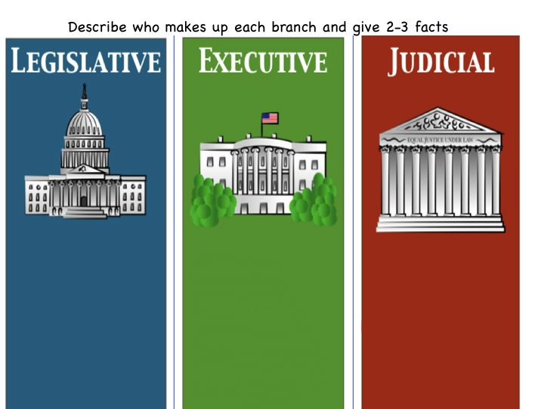
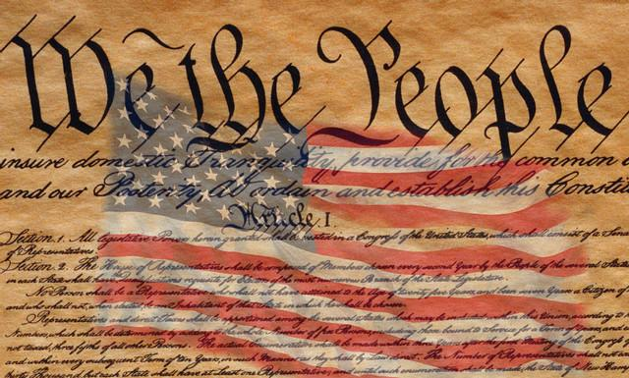
Welcome to AMERICAN GOVERNMENT
Mr. Marzolf
Room 124

Slide 2
AMERICAN GOVERNMENT
What Do We Study?
Unit 1 – Foundations of Civic &
Political Life/Foundations of Government
(3 weeks)
Unit 2 – State & Local Government (1-2 weeks)
Unit 3 – The United States & World Affairs (2-3 weeks)
Unit 4 – The 3 Branches of Government (8-9 weeks)
Unit 5 – Citizenship in the United States (2-3 weeks)

Slide 3
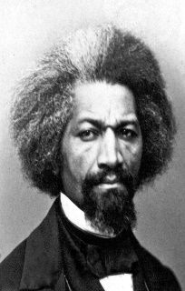
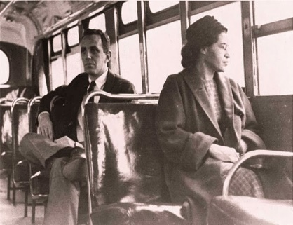
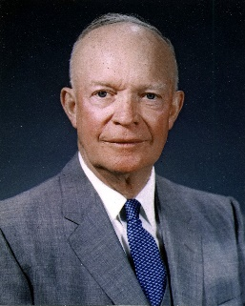
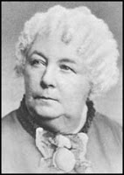
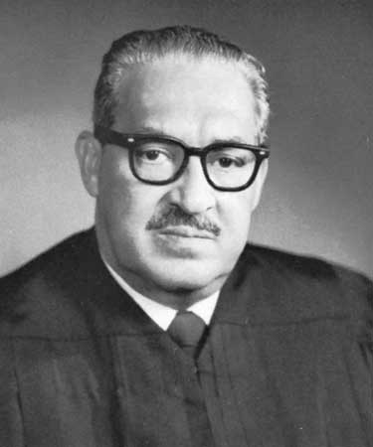
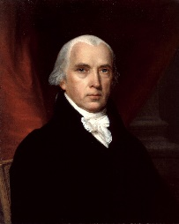
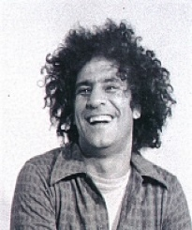
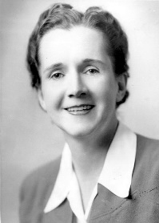
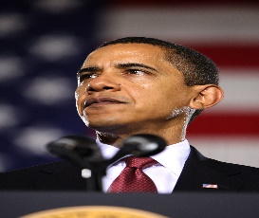
Why Do We Study American Government?
Knowledge of our Government
Origins of our Democracy
Comparative study – forms of government around the world
The U.S. Constitution
Bill of Rights + Amendments 11-27
3 Branches of Government
Check-n-Balances
Federalism/States Rights/Local Control
The U.S. role in World Affairs
How can I be an engaged citizen/American in political affairs?
Application to Our Lives
How does our government affect our daily lives & our future?
Democracy is NOT a spectator sport!
Are my needs & interests being represented by our government officials? If not, what can I do about it?
Voting = VOICE! But how else can become civically involved in my community & nation?
Why do we pay taxes & where does all the money go?
Do I know my rights? How can I apply them to my daily life?

Slide 4
Class Rules & Expectations
RULES
THE GOLDEN RULE!
R-E-S-P-E-C-T!
Effort
Participation
Integrity
Cooperation
WCS Student Code of Conduct
EXPECTATIONS
Do your best! Engage & participate.
Good attendance! Be on time to class each day and prepared to learn.
Respect one another as equal human beings and respect the opinions of those you may disagree with.
Complete assignments on time and to the best of your ability. Study for exams and cooperate with classmates on projects.

Slide 5
AMERICAN GOVERNMENT
Learning Strategies
Daily Warmups – “mental stretching” to prepare for lesson
Interactive Direct Instruction – use of Cornell Notetaking strategy
Cooperative Learning Activities – partner/group work
Graphic Organizers – flow charts, mind maps, etc. to assist students in organizing information to study
Inquiry-Based Projects – cooperative projects where students work together to explore topics of interest in great depth
Reading Comprehension Activities – guided reading activities, close & critical reading strategies, talk-to-the-text activities, etc.
Class Discussions/Debates – students are encouraged to share their ideas and opinions, ask questions, and provide insights to our studies
Critical Thinking Activities – challenge students to make more in depth connections to our studies of the past and current events.

Slide 6
AMERICAN GOVERNMENT
Grading Policy
WCS H.S. grading policy
Required course for graduation
(.5 CR/Semester)
Semester Grading
40% (Q1) + 40% (Q2) + 20% (FE) = Final Semester Grade
Refer to course syllabus for further details re: percentage/letter grade breakdown
Assessments = 75%
Tests, Quizzes, Projects, Presentations
Classwork/Homework = 25%
Absent/Late Work
EXC absent students are given extra time to complete missed work equal to the number of days absent.
I do accept late work, but students may lose points (dependent on the circumstance & length of time).
Classwork/homework requests when your child is absent can be arranged with the House Office.
Use of our class website can help you…
locate weekly lesson plans
access course materials, resources, online textbook
find my contact information

Slide 7
AMERICAN GOVERNMENT
Teacher-Student-Parent/Guardian Communications
Email – mmarzolf@wcskids.net
Phone – 586-574-3250 (x.13124)
Remind App – important text messages sent directly to student, parent/guardian cell phone to be informed of class announcements, classwork/homework, tests, quizzes & due date reminders.
How do I sign-up?
Text To: 81010
Message: @mmarzol
Class Website – mmarzolf.weebly.com

