Slide 1
Chapter 4: Federalism Section 3

Slide 2
Objectives/Learning Targets
Explain why States make interstate compacts.
Understand the purpose of the Full Faith and Credit Clause.
Describe the Extradition Clause and explain its purpose.
Explain the purpose of the Privileges and Immunities Clause.

Slide 3
Key Terms
interstate compact: an agreement made between two States or between a State and a foreign government
Full Faith and Credit Clause: the clause of the Constitution that says that each State will respect the laws, records, and court decisions of other States

Slide 4
Key Terms, cont.
extradition: the legal process of returning a fugitive to a State
Privileges and Immunities Clause: the clause in the Constitution that says that no State can make unreasonable distinctions between its own residents and those persons who live in another State

Slide 5
Introduction
How do the States work together to preserve the Union?
State governments make interstate compacts.
States offer full faith and credit to the laws, official records, and court rulings of other States.
States extradite fugitives to other States.
States respect the privileges and immunities of residents of other States.

Slide 6
Interstate Compacts
States can enter agreements with other States and with foreign governments with the consent of Congress.
The number of these agreements has increased over time.
There are interstate agreements to share law enforcement data, counter global climate change, encourage cooperation between public universities, and coordinate the conservation of water and wildlife.

Slide 7
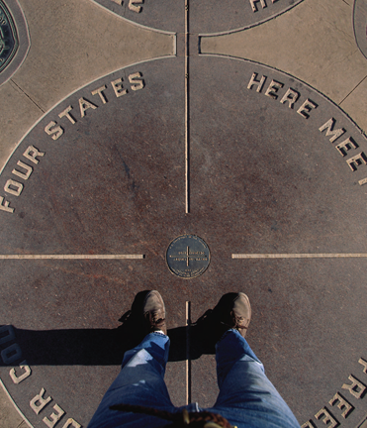
Interstate Compacts, cont.
States also cooperate to manage shared resources and border areas.
The States of Utah, Arizona, Colorado, and New Mexico meet at the “Four Corners.”

Slide 8
Full Faith and Credit
The Full Faith and Credit Clause of the Constitution requires each State to honor and enforce the laws, official documents, and court rulings of other States.
Documents issued in one State—such as birth certificates—must be accepted in all States.

Slide 9
Exceptions
There are two key exceptions to the Full Faith and Credit Clause:
It applies only to the civil laws of each State, not the criminal laws.
If a person who does not live in a State is granted a divorce by that State, the State in which that person actually resides can refuse to recognize the divorce.

Slide 10
Marriage and Divorce
Only the State in which a couple has established residency can grant them a divorce.
Same-sex marriages are now legal as determined by the U.S. Supreme Court. .
The Defense of Marriage Act (DOMA) has been found to be unconstitutional.

Slide 11
Marriage and Divorce
https://www.youtube.com/watch?v=33g-ZHBQdNU (A picture of them can be seen below)
Interracial marriage was illegal in many States until the Supreme Court ruled in 1958 that such laws were unconstitutional.
Notes:
NOTE TO TEACHERS: The above image shows Richard and Mildred Loving. The couple married in Washington D.C. in 1958, but were arrested in Virginia, their home state, where interracial marriage was illegal. The case went to the Supreme Court, which declared the Virginia law unconstitutional.

Slide 12
Extradition
The Constitution states that people charged with a crime in one State who flee to another State must be extradited—returned to the State where they were originally charged.
Typically a State governor asks another State governor to return any captured fugitives. Such requests are usually upheld.
If extradition is challenged, the federal government can order a governor to extradite a fugitive.

Slide 13
Privileges and Immunities
No State can make unreasonable distinctions between its residents and residents of another State.
Each State must recognize the right of any American to travel in or become a resident of that State.
Citizens can also marry, buy, own, rent, or sell property, and use the courts in any State, no matter where they live.

Slide 14
Privileges and Immunities, cont.
States can make reasonable distinctions between their residents and those of other States.
People can be required to live in a State for certain period of time before they can vote, hold public office, or be licensed in certain professions.
States can also charge higher fees to out-of-State hunters, fishers, or students attending a State’s public universities.

Slide 15
Privileges and Immunities, cont.
Checkpoint: Why might a State be restricted from making distinctions between its residents and those of another State?
This could lead to unfair social or economic treatment of U.S. citizens, such as preferential hiring of in-State residents or lower welfare benefits for newly arrived residents.
It could also cause conflict between States.
Notes:
Checkpoint Answer: It could lead to prejudiced treatment of people from other states or recent residents who come from other states, which would lead to conflict and would violate the 14th Amendment Equal Protection Clause.

Slide 16
Review
Now that you have learned about how the States work together to preserve the Union, go back and answer the Chapter Essential Question.
Is the federal system the best way to govern the United States?

